Slide 1

#RahoAmbitious
TechM Full-Stack Software Development

Slide 2




Course: Software Testing
Lecture On: Web UI Test Automation: Selenium
Instructor: Bibek Prasad

Slide 3
In the previous class…
You were introduced to the concept of software testing.
We discussed different testing methodologies.
You learnt how to write test plans and test cases.
You also learnt how to make a bug report.

Slide 4



Poll 1 (15 Sec)
Which of the following is an advantage of automation testing? (Note: More than one option may be correct.)
Automation testing reduces manual effort by performing repetitive tasks.
Automation testing reduces the probability of error and gives results with better precision.
In automation testing, a tester manually performs end-user tasks and verifies whether all the features are working as expected or not.
Automation testing is the practice of running tests automatically, managing test data and utilising results to improve the quality of a software.
Practice in teams of 4 students
Industry expert mentoring to learn better
Get personalised feedback for improvements
11

Slide 5
Poll 1 (Answer)
Which of the following is an advantage of automation testing? (Note: More than one option may be correct.)
Automation testing reduces manual effort by performing repetitive tasks.
Automation testing reduces the probability of error and gives results with better precision.
In automation testing, a tester manually performs end-user tasks and verifies whether all the features are working as expected or not.
Automation testing is the practice of running tests automatically, managing test data and utilising results to improve the quality of a software.
Practice in teams of 4 students
Industry expert mentoring to learn better
Get personalised feedback for improvements
11

Slide 6

Today’s Agenda
1
Understand Test Automation Process
2
Introduction to Selenium
3
Xpath, TestNG and Maven
4
WebDriver Actions
5
Verify and Assert in Selenium

Slide 7
Test Automation Process

Slide 8
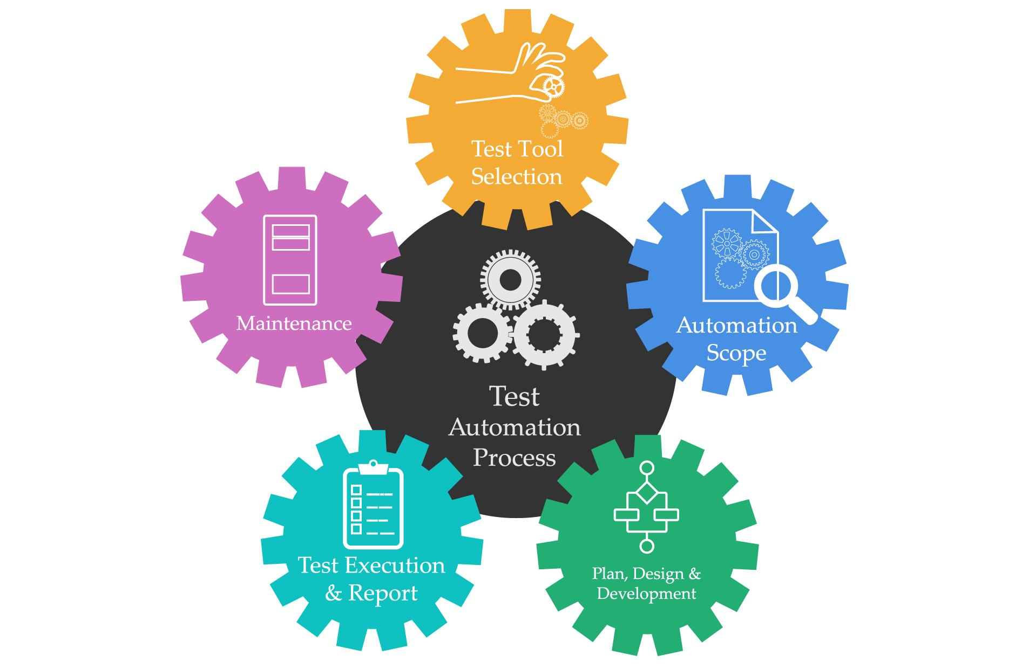
Test Automation Process

Slide 9
Introduction to Selenium

Slide 10

Introduction to Selenium
Selenium is an open source tool used to perform functional and regression testing of web applications on different browsers and operating systems.

Slide 11
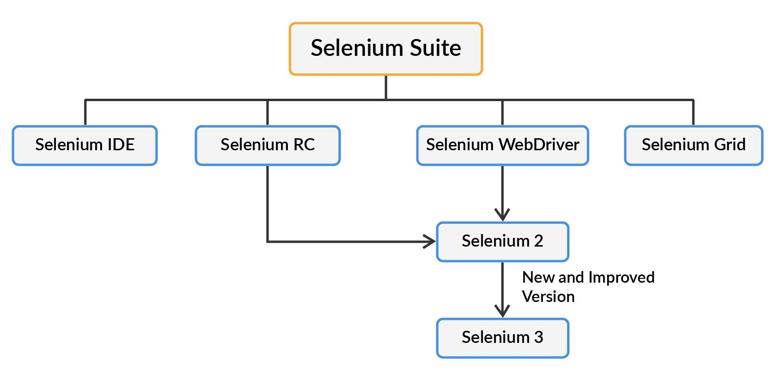
Introduction to Selenium
Components of Selenium
Selenium IDE is a simple record and playback tool that is an add-on for Mozilla Firefox and Google Chrome. IDE records the actions performed by the user in the browser and converts them to an appropriate Selenium script.
For a long time, Selenium Remote Control (RC) was the main Selenium project before the WebDriver/Selenium merge resulted in Selenium 2. Selenium RC is also known as Selenium 1 and is not used anymore.
Selenium WebDriver is the most popular tool of the Selenium suite. Selenium WebDriver drives a browser in a way that is natively similar to that in which a user would drive it; it drives the browser either locally or on a Selenium server.
Selenium Grid: Selenium Grid is mainly used for parallel or distributive testing. It allows you to execute test scripts on different virtual machines simultaneously.

Slide 12
Poll 2 (15 Sec)
Which of the following is not a component of Selenium Suite?
Selenium IDE
Selenium WebDriver
Selenium Script
Selenium Grid
Practice in teams of 4 students
Industry expert mentoring to learn better
Get personalised feedback for improvements
11

Slide 13
Poll 2 (Answer)
Which of the following is not a component of Selenium Suite?
Selenium IDE
Selenium WebDriver
Selenium Script
Selenium Grid
Practice in teams of 4 students
Industry expert mentoring to learn better
Get personalised feedback for improvements
11

Slide 14
Why UI Automation Testing?
Many a times we need to test the overall UX and not limit our testing to functional perspective only.
Tools required for automation testing are easily available and along with a rich knowledge base.
Sometimes UI automation is the best possible solution to solve the problem of daily redundant manual regression.
Testing things at UI is sort of end to end testing which will cover client side as well as server side interactions.

Slide 15
Why Backend Automation Testing?
Backend automation is less costly when compared to UI automation in terms of execution speed and stability.
Backend automation suites are less flaky when compared to UI tests.
Backend automation helps in validating the core business logic first.
Backend automation gives us a confidence by verifying all the business flows in a very quick turnaround time along with a robust test results.

Slide 16
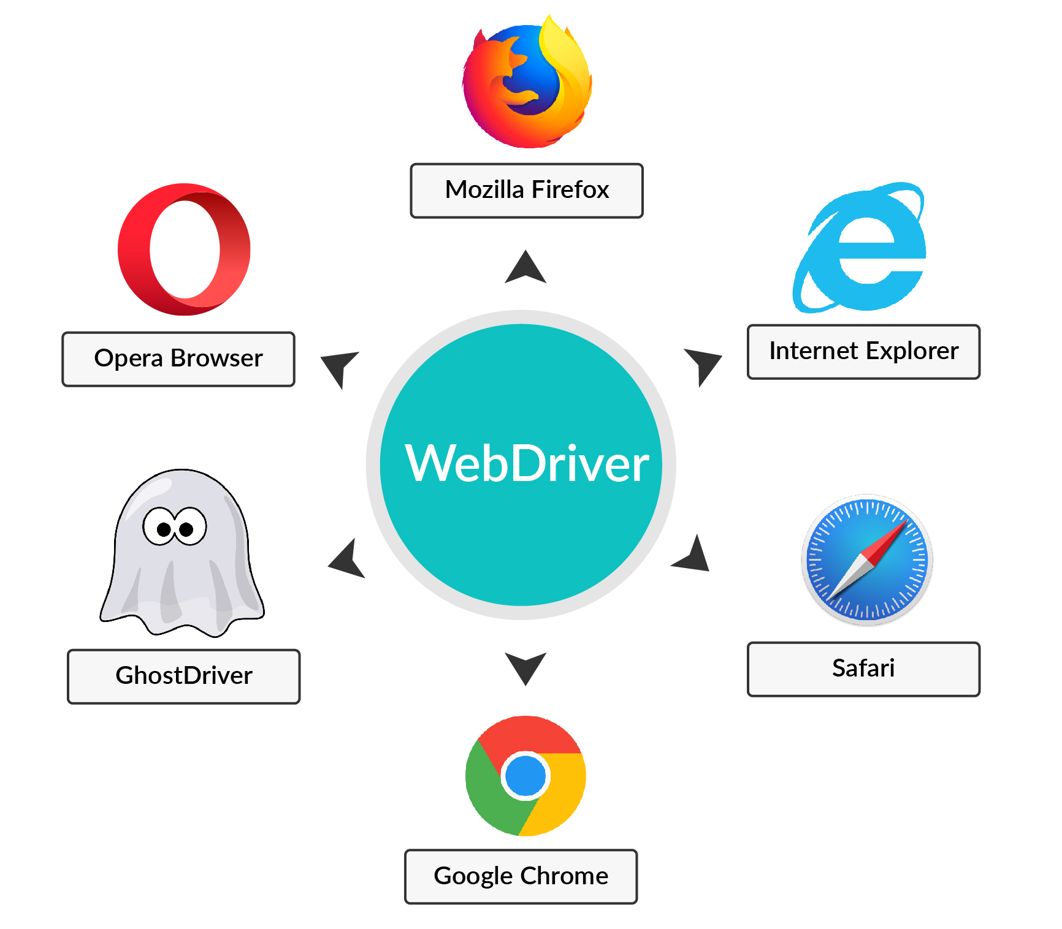
Selenium WebDriver

Slide 17
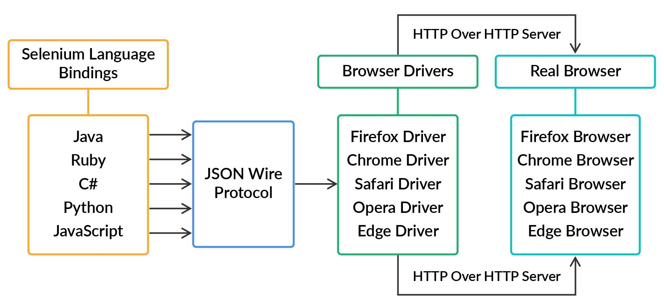
Selenium WebDriver
Architecture
Language Binding/Selenium Client Library: Jar files contain the language in which you write your Selenium framework. It means that the language that you used to write the script may be Java, Ruby, Python or JavaScript.
JSON wire protocol: JSON is a lightweight data-interchange format. It is mainly used to transfer data between the client and the server on the web. JSON wire protocol sends data in the JSON format after which the server firstly parses the data and then executes it. Finally, the response received from the server is sent back to the client in the JSON format.

Slide 18
Selenium WebDriver
Architecture
Browser drivers: Each browser contains its own separate browser driver. These drivers communicate with the respective browsers without actually revealing their internal logic. When a browser's driver receives a command, it executes the command on the respective browser and sends the response in the form of an HTTP response.
Real browsers: Selenium WebDriver supports various browsers such as Firefox, Chrome, Safari, Opera and Edge.

Slide 19
Selenium WebDriver
Internal Working
WebDriver driver = new ChromeDriver();
driver.get("https://www.zomato.com");
You can declare your WebDriver as follows:
Once you declare the driver as shown in the example above and click on run, the Selenium client library will communicate with the Selenium API.
The Selenium API will then send the command received from language-level binding to the browser driver with the help of the JSON protocol (in this case, this would be Java binding).
Then, the Selenium API will send the request to that particular browser driver (in this case, the Chrome driver).
This driver will use the HTTP server for obtaining the HTTP request, and the HTTP server will filter out all the commands that need to be executed.
Then, the individual commands in your Selenium script will be executed one by one on the browser.
Finally, the HTTP server will send the response back to the automation test script.

Slide 20
Poll 3 (15 Sec)
Which of the following is the correct way of declaring a WebDriver? (Note: More than one option may be correct.)
Driver WebDriver = new Driver();
WebDriver driver = new WebDriver();
WebDriver driver = new ChromeDriver();
WebDriver driver = new FirefoxDriver();
Practice in teams of 4 students
Industry expert mentoring to learn better
Get personalised feedback for improvements
11

Slide 21
Poll 3 (Answer)
Which of the following is the correct way of declaring a WebDriver? (Note: More than one option may be correct.)
Driver WebDriver = new Driver();
WebDriver driver = new WebDriver();
WebDriver driver = new ChromeDriver();
WebDriver driver = new FirefoxDriver();
Practice in teams of 4 students
Industry expert mentoring to learn better
Get personalised feedback for improvements
11

Slide 22
Selenium WebDriver
Advantages and Disadvantages of a WebDriver
Advantages of a WebDriver
Open source
Multiple language support
Multiple OS support
Cross-browser compatibility testing
Multiple framework support
Disadvantages of a WebDriver
Steep learning curve
No built-in image comparison
No reporting capabilities
Does not support test script grouping

Slide 23

Locators

Slide 24
Locators
Locators are essential parts of any Selenium UI automation script.
Locators help in locating different elements in the UI.
The elements present in the UI can be located by the following:
the element ID
an element’s class name
the name attribute
the HTML tag name
link text
a partial link text
the DOM structure or XPath

Slide 25
Locators
ID Locators
<div class="details">
<label for="login-email">Email ID</label>
<input name="login-email" id="login-email" type="email" required="">
<div class="extra-container" id="inner-container" style="display:none">
<p class="note">Please read all the details carefully</p>
</div>
</div>
driver.findElement(By.id("login-email"));

Slide 26
Locators
Class Locators
<div class="details">
<label for="login-email">Email ID</label>
<input name="login-email" id="login-email" type="email" required="">
<div class="extra-container" id="inner-container" style="display:none">
<p class="note">Please read all the details carefully</p>
</div>
</div>
driver.findElement(By.className("extra-container");

Slide 27
Locators
Name Locators
<div class="details">
<label for="login-email">Email ID</label>
<input name="login-email" id="login-email" type="email" required="">
<div class="extra-container" id="inner-container" style="display:none">
<p class="note">Please read all the details carefully</p>
</div>
</div>
driver.findElement(By.name("login-email"));

Slide 28
Locators
Tag Locators
<div class="details">
<label for="login-email">Email ID</label>
<input name="login-email" id="login-email" type="email" required="">
<div class="extra-container" id="inner-container" style="display:none">
<p class="note">Please read all the details carefully</p>
</div>
</div>
driver.findElements(By.tagName(p));

Slide 29
Locators
Link Text Locators
<div class="details">
<label for="login-email">Email ID</label>
<input name="login-email" id="login-email" type="email" required="">
<div class="extra-container" id="inner-container" style="display:none">
<p class="note">Please read all the details carefully</p>
<a href="https://cdn.pixabay.com/photo/2016/10/10/13/42/agree-1728448_960_720.jpg" target="_self">Terms and Conditions</a>
</div>
</div>
driver.findElement(By.linkText("Terms and Conditions"));

Slide 30
Locators
Partial Link Text Locators
<div class="details">
<label for="login-email">Email ID</label>
<input name="login-email" id="login-email" type="email" required="">
<div class="extra-container" id="inner-container" style="display:none">
<p class="note">Please read all the details carefully</p>
<a href="https://cdn.pixabay.com/photo/2016/10/10/13/42/agree-1728448_960_720.jpg" target="_self">Terms and Conditions</a>
</div>
</div>
driver.findElement(By.PartialLinkText("Terms"));

Slide 31
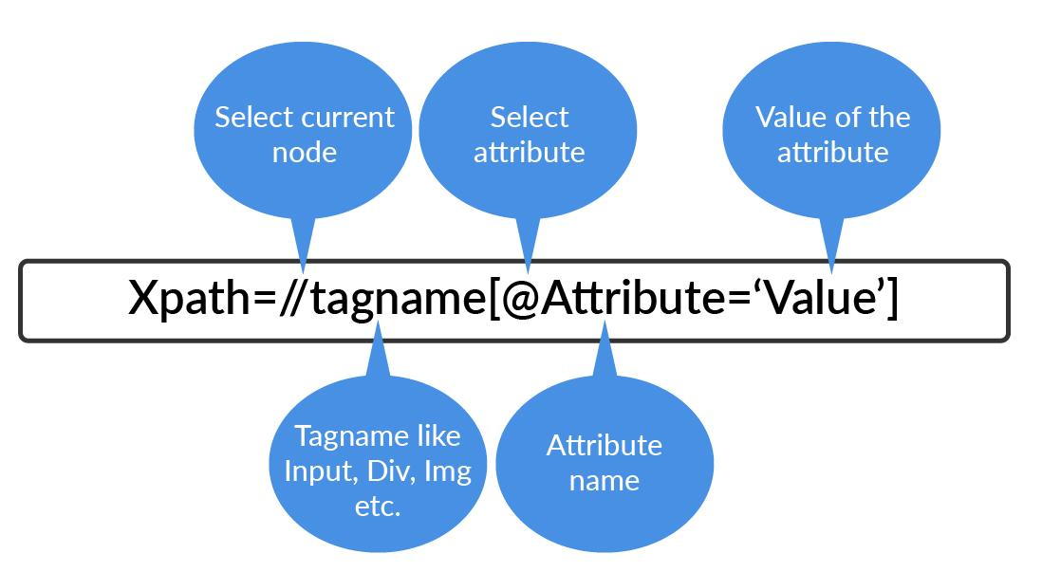
Locators
XPath Locators

Slide 32
Locators
Xpath
<form id="login">
<input name="name" type="text" value="First Name" />
<input name="name" type="text" value="Last Name" />
<input name="email" type="text" value="Business Email" />
<input name="password" type="password" class="password" />
<input name="continue" type="submit" value="Sign Me Up" />
</form>
driver.findElement(By.xpath("//input[contains(@class, 'password')]"));
driver.findElement(By.xpath("//form[input/@name='email']"));
driver.findElement(By.xpath("//form[@id='login']/input[1]"));
driver.findElement(By.xpath("//form[@id='login']/input[2]"));

Slide 33
Locator
Xpath using AND/OR
<form id="login">
<input name="name" type="text" value="First Name" />
<input name="name" type="text" value="Last Name" />
<input name="email" type="text" value="Business Email" />
<input name="password" type="password" class="password" />
<input name="continue" type="submit" value="Sign Me Up" />
</form>
driver.findElement(By.xpath(“//input[@type='text' OR @name='email’]));
driver.findElement(By.xpath(“//input[@type='text' AND @name='password’]));

Slide 34
Locator
Xpath using Text
<div class="extra-container" id="inner-container">
<p class="note">SIGN UP</p>
</div>
driver.findElement(By.xpath(“//p[@text()=’SIGN UP’]”));

Slide 35
Locator
Absolute XPath
<html>
<head>
<title>HTML Page</title>
</head>
<body>
<div class="container">
<div class="inner-container">
<div class="inner-inner-container">
<div class="inner-inner-inner-container">
<p>Welcome to
<strong>upGrad</strong>
</p>
</div>
</div>
</div>
</div>
</body>
</html>
It is a direct way to find an element.
However, the disadvantage of using the absolute XPath is that if a modification is made in the path of the element, then the XPath fails, i.e., it is unable to locate that element. Such an XPath starts with a single forward slash (/).
In the adjoining HTML code, if you want to find the absolute XPath of <strong>, then it would be as follows:
/html/body/div/div/div/div/p/strong

Slide 36
Locators
Relative XPath
<html>
<head>
<title>HTML Page</title>
</head>
<body>
<div class="container">
<div class="inner-container">
<div class="inner-inner-container">
<div class="inner-inner-inner-container">
<p>Welcome to
<strong>upGrad</strong>
</p>
</div>
</div>
</div>
</div>
</body>
</html>
Relative Xpath starts from the middle of the HTML DOM structure.
It starts with a double forward slash (//), which means that it can search the element anywhere in the entire DOM.
The relative XPath of <strong> in the alongside code is as follows:
//div[@class='inner-inner-inner-container']/p/strong

Slide 37
Hands-On Exercise 2 (5 mins)
Lets try finding locators for zomato login button (relative xpath, css).

Slide 38
Hands-On Exercise 2 - Solution
rel xpath: //a[contains(text(),'Login')]
css selector: div.sc-iGrrsa.jpaQMh div.sc-vBKru.goRwNz header.yvzia9-1.jvbMXE nav.yvzia9-2.fEwfyv ul.sc-3o0n99-3.fIVbKv li.sc-3o0n99-4.kAUthO:nth-child(2) > a.sc-3o0n99-5.bCkRtP

Slide 39
Locators
XPath: Best Practices
Avoid using XPath locators that depend on the information that has a tendency to change in the future because it will make the locators easily breakable.
The Selenium locator should be precise with only the required information.

Slide 40
Poll 4 (15 Sec)
Which of the following is the correct command for locating an element with the ID 'main-container'?
driver.findElement("main-container");
driver.findElement(id("main-container"));
driver.findElement(By.id("main-container"));
driver.findElements(By.id("main-container"));
Practice in teams of 4 students
Industry expert mentoring to learn better
Get personalised feedback for improvements
11

Slide 41
Poll 4 (Answer)
Which of the following is the correct correct command for locating an element with the ID 'main-container'?
driver.findElement("main-container");
driver.findElement(id("main-container"));
driver.findElement(By.id("main-container"));
driver.findElements(By.id("main-container"));
Practice in teams of 4 students
Industry expert mentoring to learn better
Get personalised feedback for improvements
11

Slide 42
Poll 5 (15 Sec)
For the code given in the adjoining screenshot, what would be the correct relative XPath of <h5>?
//div[@class='inner-inner-inner-container']/p/h5
/html/body/div/div/div/h5
//div[@class='inner-inner-container']/h5
/html/body/div/div/div/div/h5
<!DOCTYPE html>
<html>
<head>
<title>HTML Page</title>
</head>
<body>
<div class="container" style="background-color: red">
<div class="inner-container">
<div class="inner-inner-container">
<h5>Welcome to upGrad</h5>
<div class="inner-inner-inner-container">
<p>Welcome to <strong>upGrad</strong></p>
</div>
</div>
</div>
</div>
</body>
</html>
Practice in teams of 4 students
Industry expert mentoring to learn better
Get personalised feedback for improvements
11

Slide 43
Poll 5 (15 Sec)
For the code given in the adjoining screenshot, what would be the correct relative XPath of <h5>?
//div[@class='inner-inner-inner-container']/p/h5
/html/body/div/div/div/h5
//div[@class='inner-inner-container']/h5
/html/body/div/div/div/div/h5
<!DOCTYPE html>
<html>
<head>
<title>HTML Page</title>
</head>
<body>
<div class="container" style="background-color: red">
<div class="inner-container">
<div class="inner-inner-container">
<h5>Welcome to upGrad</h5>
<div class="inner-inner-inner-container">
<p>Welcome to <strong>upGrad</strong></p>
</div>
</div>
</div>
</div>
</body>
</html>
Practice in teams of 4 students
Industry expert mentoring to learn better
Get personalised feedback for improvements
11

Slide 44
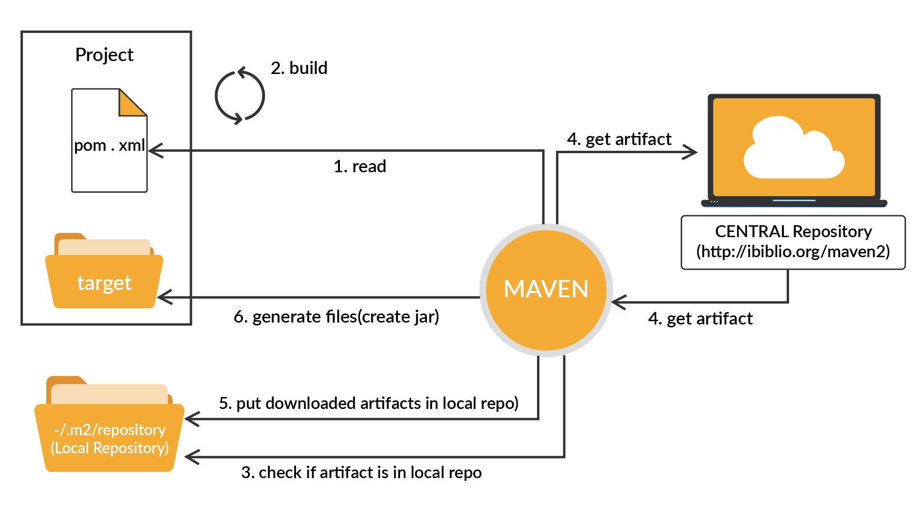
Maven

Slide 45
Maven
What is Maven?
Maven is a build management tool, which performs a programmer’s job of running code using a single command.
Maven generates the source code, compiles the code, packages the code to a jar, runs the tests, generates the reports, etc., thus making a programmer’s life easy by effectively handling massive projects.
You should use maven for the following purposes:
To manage all dependencies
To integrate a test to the pipeline
To generate and publish artifacts
To generate a test report after every test run

Slide 46
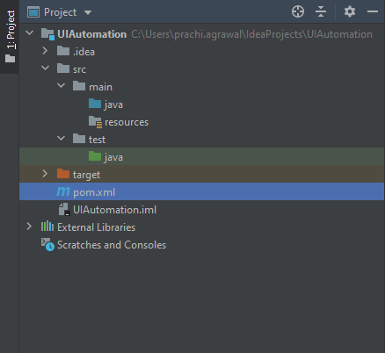
Maven
Directory Structure

Slide 47
Maven
Dependencies
<dependencies>
<dependency>
<groupId>org.seleniumhq.selenium</groupId>
<artifactId>selenium-java</artifactId>
<version>3.14.0</version>
</dependency>
<dependency>
<groupId>org.testng</groupId>
<artifactId>testng</artifactId>
<version>6.11</version>
<scope>compile</scope>
</dependency>
</dependencies>
Refer this for pom.xml

Slide 48
Poll 6 (15 Sec)
In Maven, the project dependencies are added inside?
src/test
src/main
pom.xml
External Libraries
Practice in teams of 4 students
Industry expert mentoring to learn better
Get personalised feedback for improvements
11

Slide 49
Poll 6 (15 Sec)
In Maven, the project dependencies are added inside?
src/test
src/main
pom.xml
External Libraries
Practice in teams of 4 students
Industry expert mentoring to learn better
Get personalised feedback for improvements
11

Slide 50
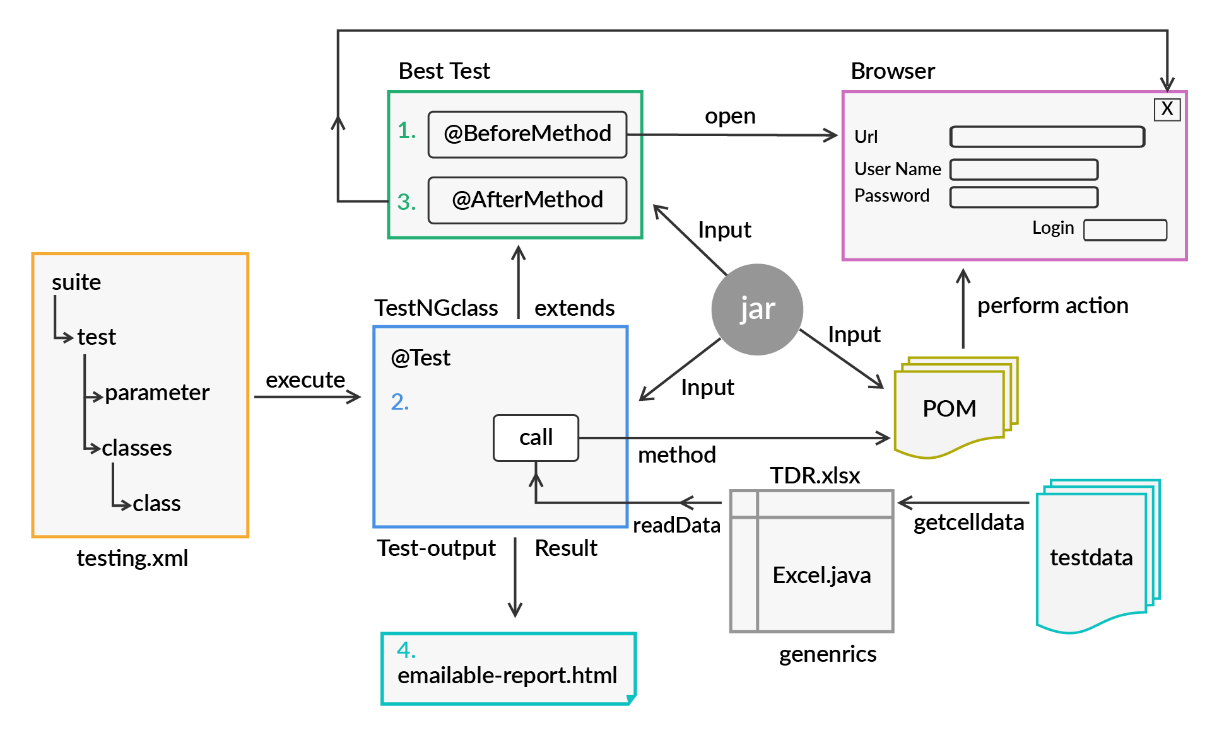
TestNG

Slide 51
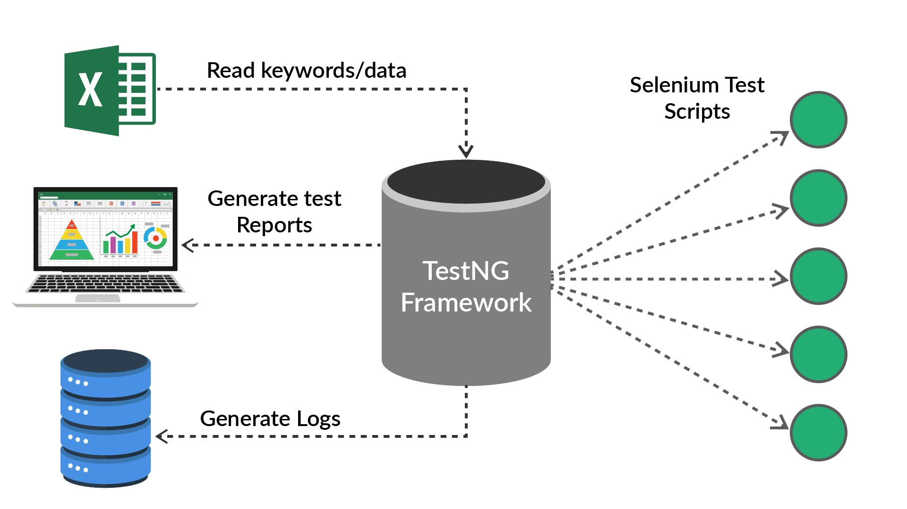
TestNG
It is an automation framework.
It is inspired from JUNIT and is designed to make end-to-end testing easy.
It uses the annotation @.

Slide 52
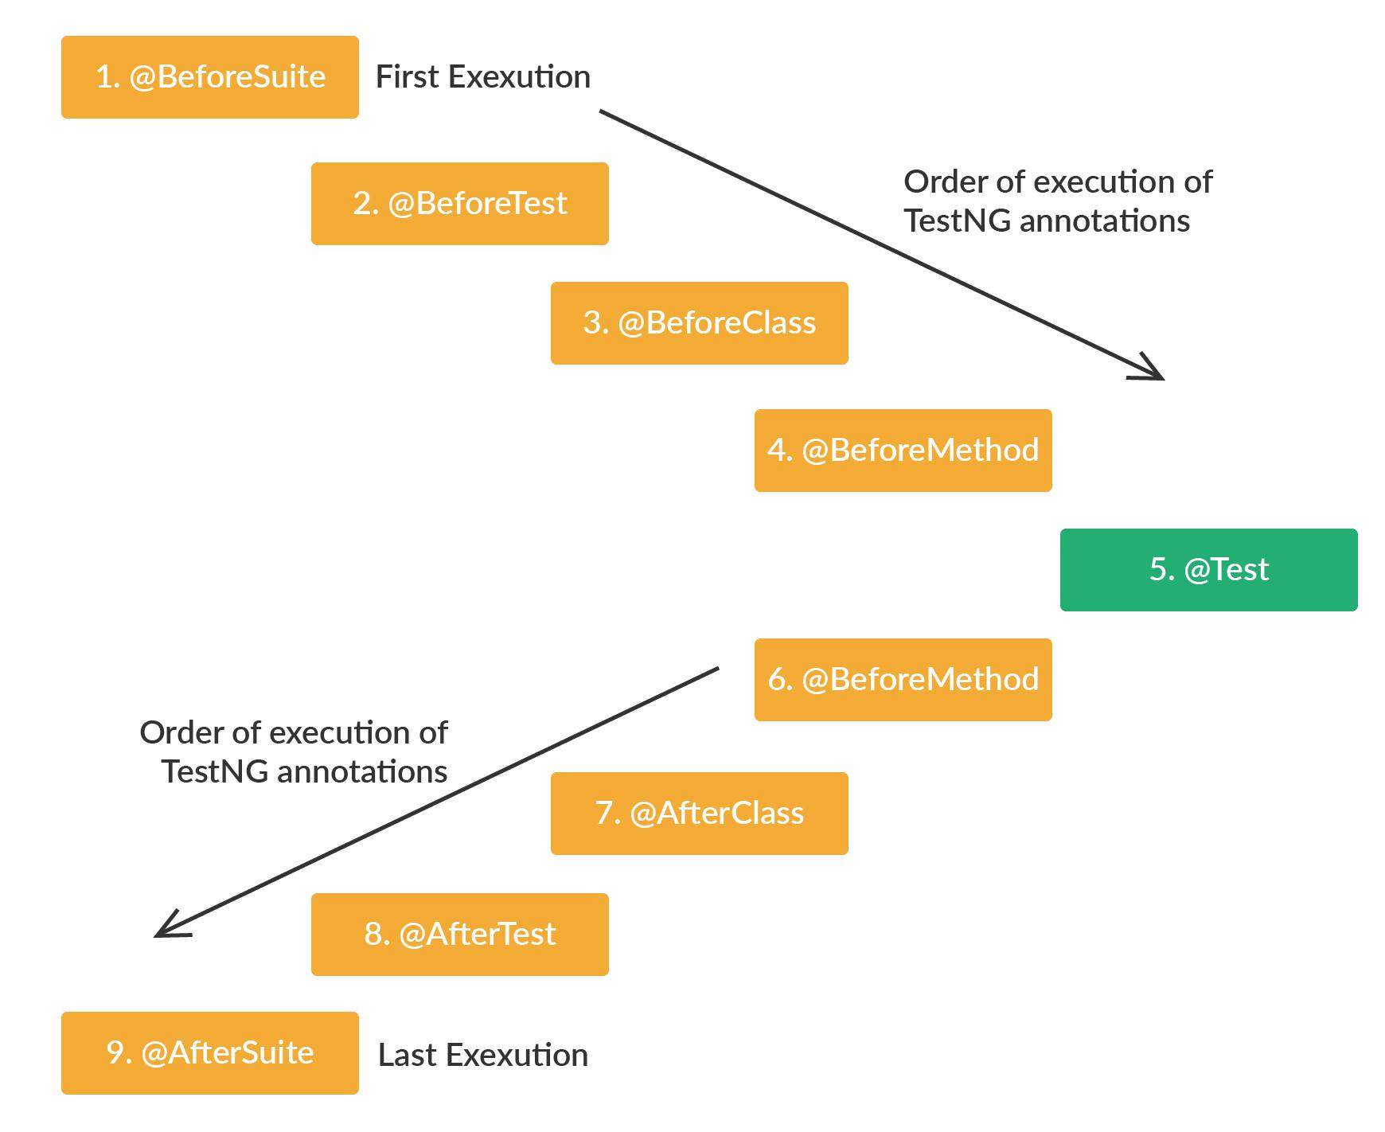
TestNG
The basic annotations used in TestNG are as follows:
@BeforeSuite: This annotated test will run before all the other tests in the suite.
@AfterSuite: This annotated test will run after all the tests in the suite.
@BeforeTest: This annotated test will run before all the tests belonging to a particular class run.
@AfterTest: This annotated test will run after all the tests belonging to a particular class run.

Slide 53
TestNG
@BeforeClass
public void setUp() throws MalformedURLException, AWTException {
initialization();
landingPage = new LandingPage(driver);
}
@Test(priority=1)
public void landingPageTitleTest() throws InterruptedException {
Thread.sleep(2000);
String title = landingPage.validateLandingPageTitle();
Assert.assertEquals(title, "Restaurants - Delhi NCR Restaurants, Restaurants in Delhi NCR | Zomato India");
}

Slide 54
TestNG
@Test(priority=5)
public void verifyZomatoLogo() throws InterruptedException {
landingPage.validateLogoIsPresent();
}
@AfterClass
public void tearDown(){
driver.quit();
}

Slide 55
Poll 7(15 Sec)
In TestNG, @BeforeSuite should be executed before @BeforeTest?
True
False
Practice in teams of 4 students
Industry expert mentoring to learn better
Get personalised feedback for improvements
11

Slide 56
Poll 7(Answer)
In TestNG, @BeforeSuite should be executed before @BeforeTest?
True
False
Practice in teams of 4 students
Industry expert mentoring to learn better
Get personalised feedback for improvements
11

Slide 57
WebDriver Action

Slide 58
WebDriver Actions
The action class in the WebDriver is used to sense the action performed.
The Selenium WebDriver provides an interface for the following two types of actions:
Actions performed by the mouse
Actions performed by the keyboard
The various actions performed on the mouse interface are as follows:
click()
doubleClick()
contextClick()
dragAndDrop()
moveToElement()
The various actions performed on the keyboard interface are as follows:
sendkeys()
keyUp()
keyDown()
Let’s look at how different action methods work in practice.

Slide 59
WebDriver Actions
The following code will be used to launch the Chrome browser using the Selenium WebDriver:
package com.upgrad.selenium.Chrome;
import org.openqa.selenium.WebDriver;
import org.openqa.selenium.chrome.ChromeDriver;
public class ChromeDriver {
public static void main(String[] args) {
WebDriver driver= new ChromeDriver();
driver.get("https://zomato.com");
driver.close();
}
}

Slide 60
Poll 8(15 Sec)
Which of the following is not a WebDriver Action?
(Note: More than one option may be correct.)
click()
upKey()
keyUp()
drag()
Practice in teams of 4 students
Industry expert mentoring to learn better
Get personalised feedback for improvements
11

Slide 61
Poll 8(Answer)
Which of the following is not a WebDriver Action?
(Note: More than one option may be correct.)
click()
upKey()
keyUp()
drag()
Practice in teams of 4 students
Industry expert mentoring to learn better
Get personalised feedback for improvements
11

Slide 62
Selenium Exceptions

Slide 63
Selenium Exceptions
TimeoutException: when there is not enough time for a command to completely execute
UnableToCreateProfileException: when opening a browser with specific options using profiles, but sometimes a new version of Driver server or browser may not support these profiles.
UnableToSetCookieException: When driver is unable to set cookie
UnexpectedAlertPresentException: when an unexpected alert comes up in the ongoing flow
NoSuchElementException: When unable to find any element
NoSuchFrameException: If the frame being targeted is not present/accessible
NoSuchWindowException: If the window is not present

Slide 64
Poll 9(15 Sec)
When does Selenium throw 'NoSuchElementException'?
When the Selenium WebDriver is unable to set cookies.
When the Selenium WebDriver is unable to find a particular element.
When the the frame being looked by the WebDriver is not present/accessible.
When the WebDriver does not have enough time for a command execution.
Practice in teams of 4 students
Industry expert mentoring to learn better
Get personalised feedback for improvements
11

Slide 65
Poll 9 (Answer)
When does Selenium throw 'NoSuchElementException'?
When the Selenium WebDriver is unable to set cookies.
When the Selenium WebDriver is unable to find a particular element.
When the the frame being looked by the WebDriver is not present/accessible.
When the WebDriver does not have enough time for a command execution.
Practice in teams of 4 students
Industry expert mentoring to learn better
Get personalised feedback for improvements
11

Slide 66
Verify and Assert in Selenium

Slide 67
Verify in Selenium
Verify commands are used in Selenium script to make them more smart.
Verify commands help in verifying if a specific text is present or not on the webpage, if a certain element is present or not on the webpage and if the position of a particular element is correct or not.
The verify commands that are used in Selenium are:
verifyElementPresent: this command return TRUE if the element is present otherwise it returns FALSE.
verifyElementNotPresent: this command return true if the specified element is not present in the DOM, otherwise it returns TRUE.
verifyTextPresent: this command returns true if the specified text is found somewhere on the webpage.
verifyTextNotPresent: this command return true if the specified text is not present in the DOM, otherwise it returns TRUE.
verifyElementPositionLeft: It checks if the specified element is placed at the mentioned distance from the left edge of the page.
verifyElementPositionTop:It checks if the specified element is placed at the mentioned distance from the top edge of the page.

Slide 68
Assert in Selenium
Assert helps us to compare the obtained result and the expected result.
There are two types of assertion:
Hard assertion: When an assert statement fails, hard assertion throws an exception and later continues with the next tests in the test suite. The different types of hard assertions are:
assertEquals
assertNotEquals
assertTrue
assertFalse
assertNull
assertNotNull
Soft assertion: When an assert statement fails, soft assertion does not throw an exception and continues with the next tests in the test suite.

Slide 69
Poll 10(15 Sec)
Which is not a valid Selenium verify command?
verifyTextPresent
verifyNull
verifyElementNotPresent
verifyElementPositionTop
Practice in teams of 4 students
Industry expert mentoring to learn better
Get personalised feedback for improvements
11

Slide 70
Poll 10(Answer)
Which is not a valid Selenium verify command?
verifyTextPresent
verifyNull
verifyElementNotPresent
verifyElementPositionTop
Practice in teams of 4 students
Industry expert mentoring to learn better
Get personalised feedback for improvements
11

Slide 71

Project Work (30 mins)
Online Food Ordering Website
Take a look at the following use case and automate Zomato’s online order flow:
Launch zomato.com
Search item (chicken)
Launch KFC from the search result
Verify the KFC page
Run tests as testNG
Run tests as mvn tests
Validate the TestNG reports
You can refer to the solution here.

Slide 72
Doubt Clearance (15 min)

Slide 73
Key Takeaways
You were introduced to Selenium WebDrivers.
You learnt about the architecture of the Selenium WebDriver.
You also learnt about the different locators used in automation scripting.
You gained an understanding of different WebDriver Actions.

Slide 74
Tasks to Complete After Today’s Session
MCQs
Project - Checkpoint 2

Slide 75
In the next class, you will learn...
Implicit and explicit wait in selenium
The different frameworks used in automation testing.
Introduction to backend testing

Slide 76
#RahoAmbitious
Thank you!

